Slide 1
Intent Mining in Conversation
Ronnakorn Rattanakornphan (Ron)

Slide 2
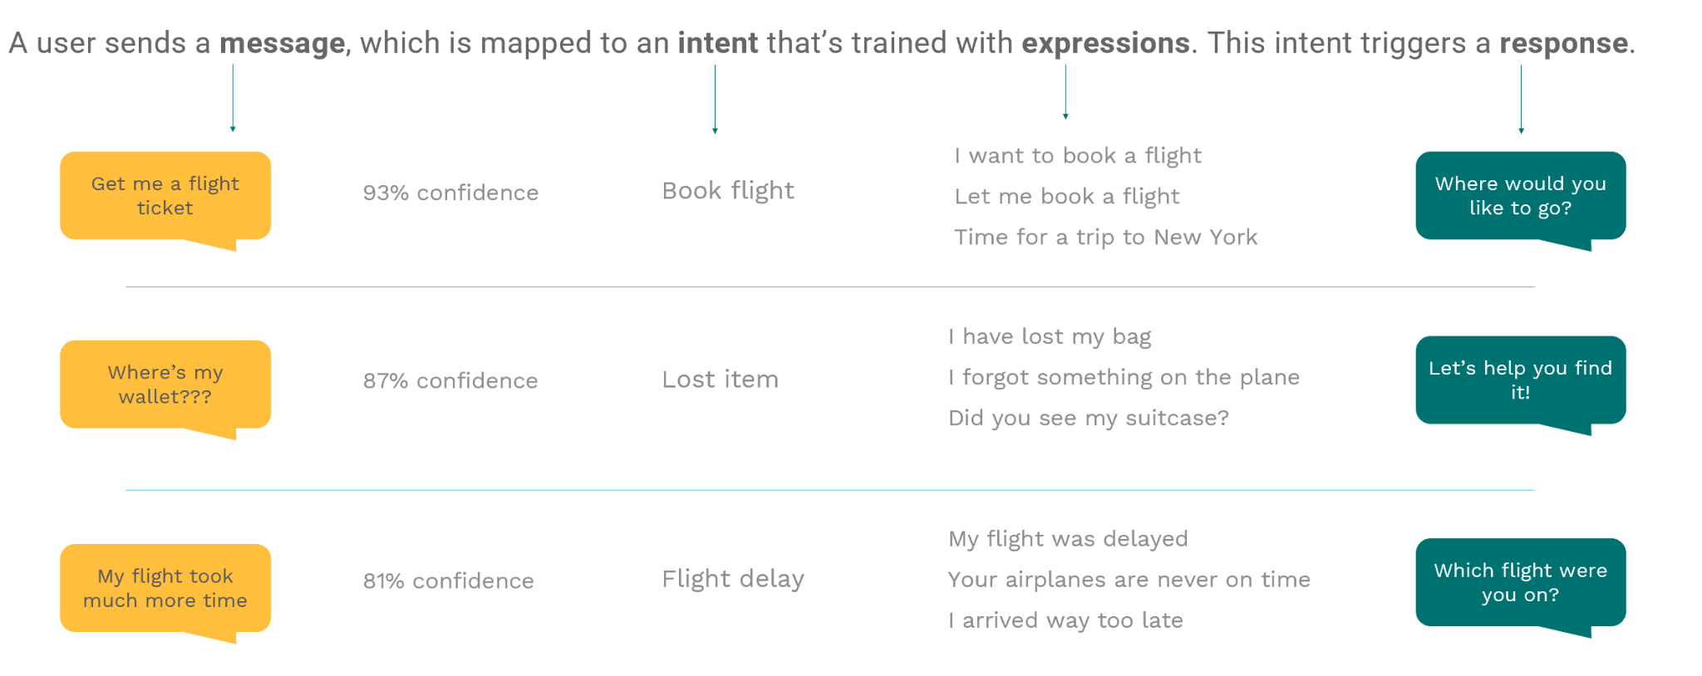
Conversion data
img src: https://docs.chatlayer.ai/understanding-users/natural-language-processing-nlp

Slide 3
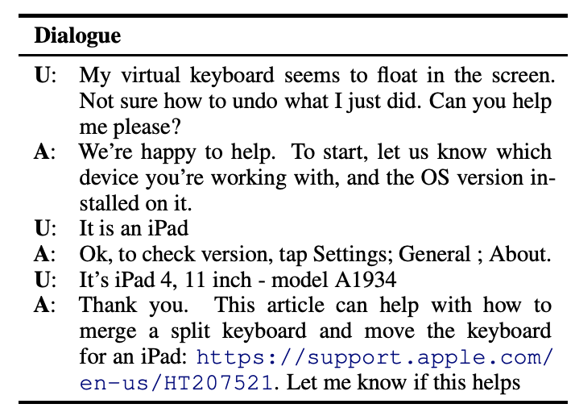
Problem
Labeling intent dataset is hard
Text classification/summarization
Different opinion in each labelers
Different from 1 task to another
Same conversation can be labeled differently
Want to automate the labeling process
example of dialog data

Slide 4
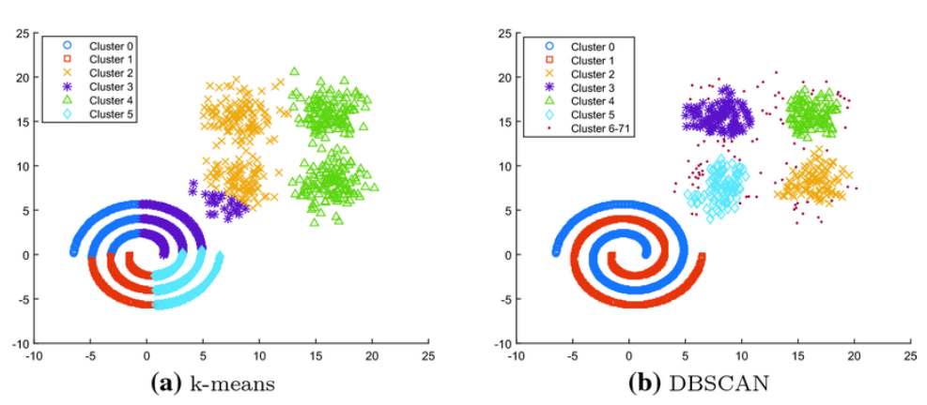
Similar (previous) work
Map the conversation (text) into embedding space (vector)
universal sentence encoder
Perform clustering
iter-DBSCAN
Label some (or one) representative
Propagate the label
example of DBSCAN

Slide 5
Our method
Automatic labeling on conversation dataset, Auto-Label
Unsupervised approach
No human intervention needed
Use combination of
Clustering (DBSCAN)
Keyword extraction (transformer)
Zero-shot text classification (transformer)

Slide 6
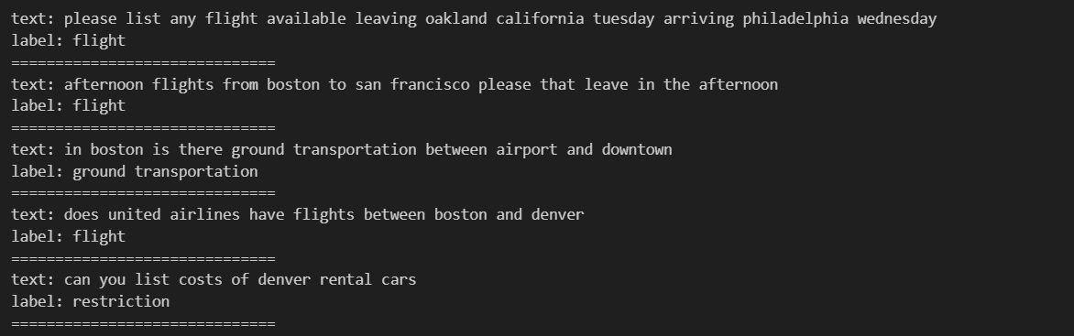
Example of Auto-Label

Slide 7
Method
Achieve the labeling with zero or minimal human input
Text embedding
Sentence-BERT (transformer)
Clustering
DBSCAN
Generating label candidate
Keyword extraction using KBIR-OpenKP
Variant of RoBERTa transformer model
Zero-shot classification
BART (transformer)

Slide 8
Dataset
Metrics
ATIS (Airline Travel Information Systems)
Homogeneity score
Completeness score
Normalized mutual information (NMI)
Adjusted mutual information
Adjusted rand score

Slide 9
Result
score\method | DBSCAN | ITERDBSCAN | Auto-Label
Homogeneity score | 0.14 | 0.34 | 0.33
Completeness score | 0.29 | 0.11 | 0.65
Normalized mutual information (NMI) | 0.19 | 0.17 | 0.44
Adjusted mutual information | 0.17 | 0.11 | 0.44
Adjusted rand score | 0.13 | -0.06 | 0.49

Slide 10
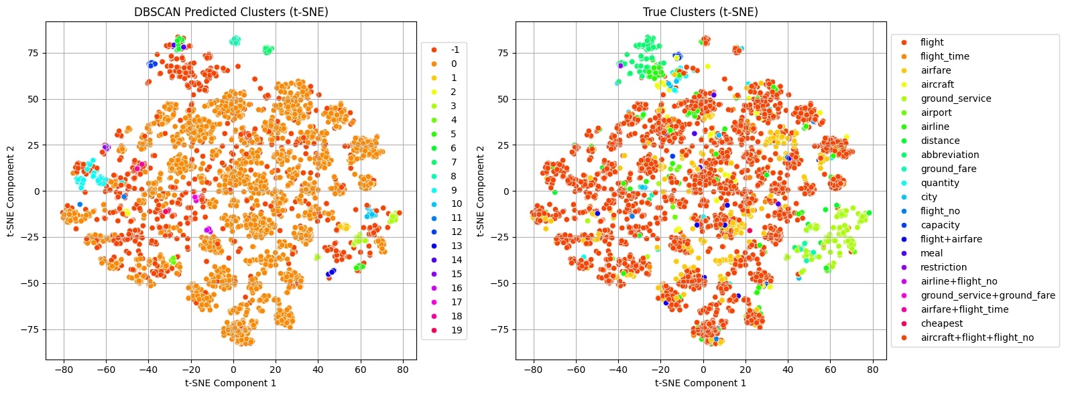
Result
DBSCAN clustering result compared to the true cluster.

Slide 11
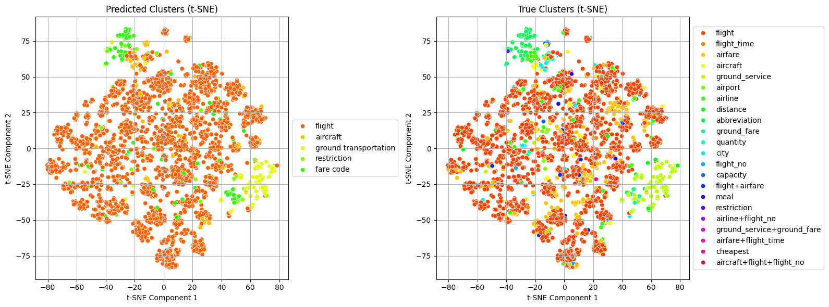
Result
Auto-Label clustering result compared to the true cluster.

Slide 12
Limitation
Requires a total of 4 different transformer models
Slow
Require extra memory to store models
Usage of keyword extraction means that the text label must be a substring of existing text
user query of “Which road do I take to evade traffic?”
would be labeled as “road” or “traffic” rather than “navigation.”

Slide 13
Conclusion
We present Auto-label, an unsupervised approach to automatically label unseen data.
Allows us to obtain a labeled dataset from an unlabeled one without human intervention.
The method uses a combination of clustering algorithm and transformer models.

Slide 14
Future work
improve the keyword extraction
infer a meaningful keyword rather than restricted to a substring of existing text
mask the entity in the original text with a common term
“When is the flight from Boston to California?”
would become “When is the flight from [location1] to [location2]?”

Slide 15
Thank you
Ronnakorn Rattanakornphan (Ron)

